Slide 1
L2_Drawing Instruments and Line types
B. SANTHI
Assistant t Professor
Department of MECHANICAL Engineering
NIT Goa

Slide 2
Items required for Drawing class
Drawing board
Drawing sheet – A2 Size
Mini-drafter/ Drafting machine/ T-Square
Instrument box containing Compass, Bow Compass, Divider
Scale( Ruler)
Protractor, ProCircle
Drawing pencils- 2H,H, HB, B
Drawing sheet Holder
Sharpener, Eraser
Drawing clip/Adhesive tape ->Paper Knife
Cloth to Clean
Rough Sheets

Slide 3
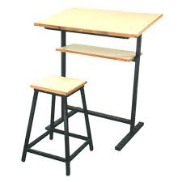
Drawing board

Slide 4
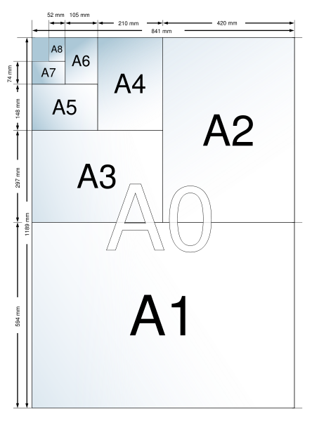
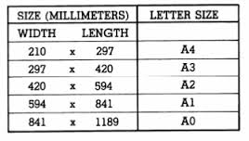
Drawing Sheet

Slide 5
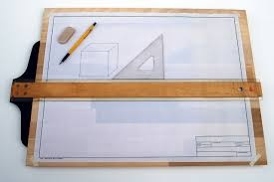
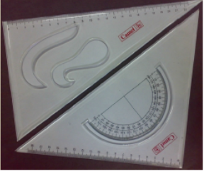
T-Square
Set square

Slide 6
Mini-Drafter

Slide 7
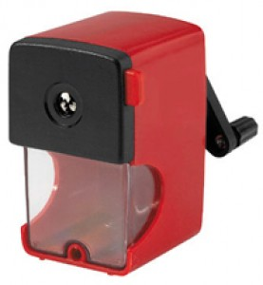

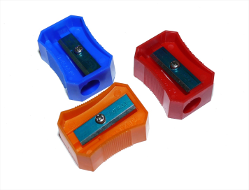
Drawing Clips

Slide 8
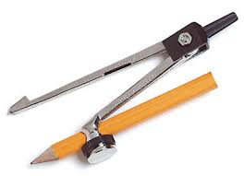
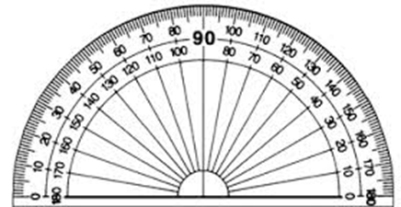
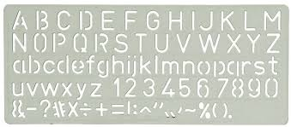
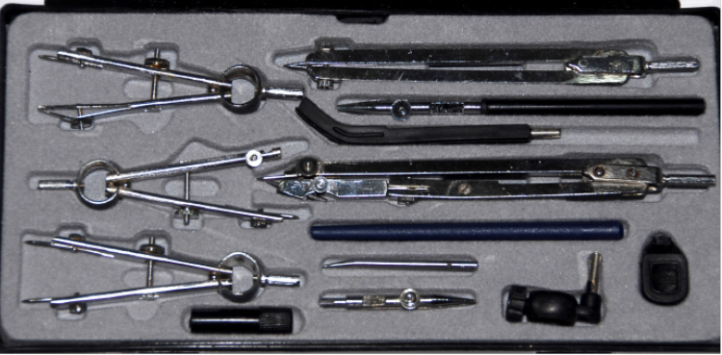
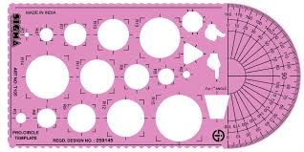
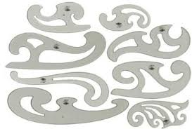
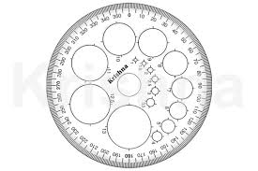
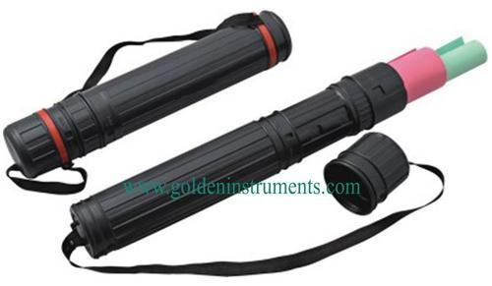
Protector
Bow Compass
Drawing Box
French Curve
Drawing Paper Holder
Pro-Circle

Slide 9
Drawing Sheet Layout
Drawing Space
Trimmed sheet
Drawing margin
Title Block
Location - Bottom right corner – 185 mm x 65 mm (BIS)

Slide 10
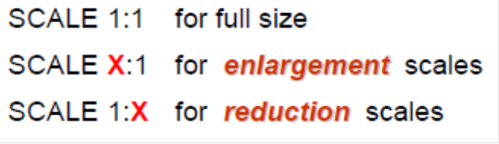
NATIONAL INSTITUTE OF TECHNOLOGY, GOA
20
TITLE: LETTERING
15
NAME: B SANTHI
10
ROLL NO:
SCALE: 1: 1
10
DATE:
BATCH:
CHECKED BY
10
110
75

Slide 11
Introduction - Lines
The word language is inadequate for describing the size, shape and features completely as well as concisely.
Graphics Language
- Lines
Dimensioning
(Combination of both graphic and word language)

Slide 12
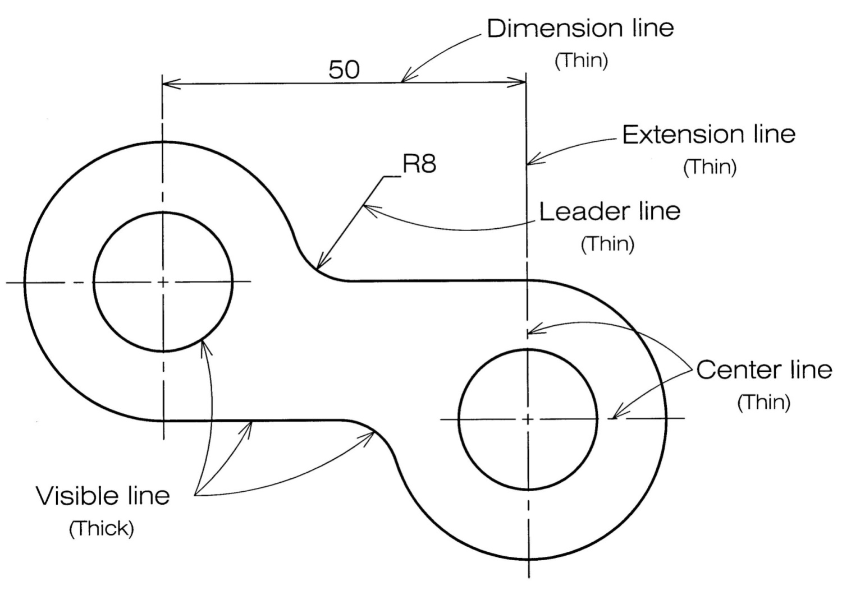
Introduction – Line Types
Each line on a drawing represents specific precise information
regarding the components design.

Slide 13
Types of Lines
Common

Slide 14
Types of Lines
Special

Slide 15
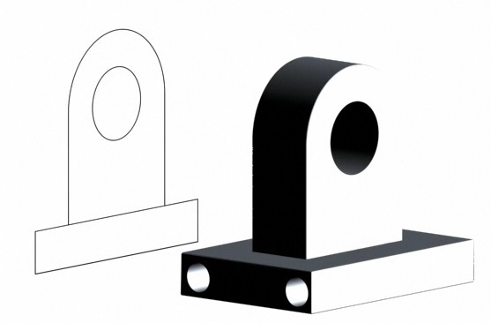
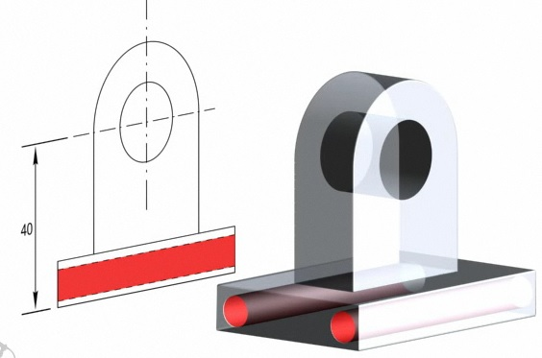
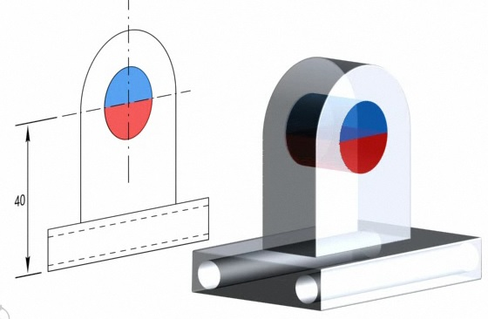
Visible lines
To draw outlines of visible edges.
Drawn in continuous thick lines.
Hidden lines
Medium thick lines.
To draw invisible edges.
Center lines
Thin lines with alternate long dash and dot.
To draw symmetrical objects.

Slide 16
Example of different Lines in a drawing

Slide 17
Good
Bad

Slide 18
Thank You

